Slide 1

EMERGE
VIRTUAL SCHOOL
2025 – 2026 Prospectus

Slide 2





NAVIGATE
Welcome from our Headteacher
Therapeutic Approach
Admissions Criteria and Process
Ethos
Our Values
Our School
Our Curriculum
Contact Us

Slide 3


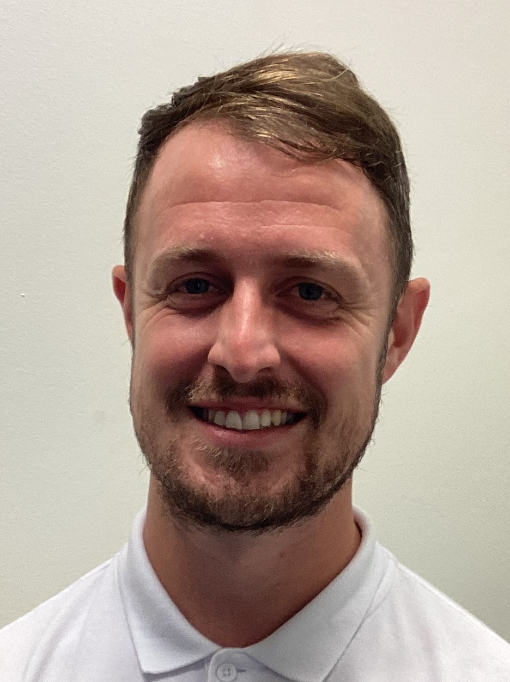

WELCOME
FROM OUR HEADTEAHCER
ANDY GOULD
Welcome to Our Virtual School Prospectus
Dear students, parents, and carers,
It gives me great pleasure to welcome you to our prospectus and to introduce you to the vibrant community of Emerge Online School. We are a therapeutically informed online SEN (Special Educational Needs) school, providing high-quality education for young people aged 5 to 16. Our mission is to re-engage learners who may have become disengaged from education, by offering a safe, flexible, and supportive online learning environment.
We specialise in supporting pupils with a primary need related to Autistic Spectrum Condition (ASC), ADHD, Speech, Language and Communication Needs (SLCN), anxiety and emotionally based school avoidance, as well as Social, Emotional, and Mental Health (SEMH) needs. Every student benefits from the wealth of therapeutic education expertise deeply embedded within Emerge, ensuring that learning is both academically rigorous and emotionally nurturing.
At the heart of everything we do are our core values—Voice, Connection, Growth, and Inclusion. We believe every child deserves to be heard, to experience a genuine sense of belonging, to be supported in their personal and academic journey, and to be celebrated for who they are.
As a virtual school, we harness the power of technology to remove barriers and open doors, creating meaningful connections between pupils, families, and teachers—wherever they may be. Through strong relationships, high expectations, and a caring, therapeutically informed environment, we help our pupils to build confidence, resilience, and ambition for the future. Our in-house clinical team provides tailored support, empowering students to navigate their social, emotional, and behavioural challenges with care and expertise.
This prospectus offers a window into how our values shape daily life in our virtual classrooms and how we work together to ensure that every young person entrusted to us not only succeeds, but truly thrives.

Slide 4

Our ETHOS
Therapeutically informed online education
At Emerge Virtual School, we have drawn upon the wealth of expertise and insight developed in our established SEN school and reimagined it within a dynamic online setting.
Our online school delivers a broad, carefully designed curriculum that pupils can access from the comfort of their own homes. This enables them to work towards recognised qualifications that open pathways to further education, training, or employment.
Our dedicated team is both skilled and deeply committed, placing encouragement and reassurance at the centre of everything we do. We strive to create a calm, supportive environment where consistent, empathetic communication helps students who may have found traditional schooling challenging. Staff are trained to identify early signs of anxiety or disengagement and respond with tailored one-to-one support that fosters trust, resilience, and self-belief.
Alongside their academic studies, pupils benefit from personalised therapeutic input that helps them understand and manage the wider developmental challenges they face. This holistic approach equips them with the strategies and confidence they need not only for success in education but also for life beyond the classroom.
On joining us, every student undertakes a series of academic and therapeutic assessments. These provide a comprehensive picture of their strengths, social and emotional needs, and areas for growth. Using this profile, our staff design a bespoke timetable and adapt lessons to maximise engagement and progress.
This highly individualised model sets Emerge Virtual School apart. While we may not share a physical space with our learners, we work tirelessly to ensure that lessons are creative, engaging, and inspiring for every child. Above all, our goal is to help students rekindle their curiosity, rediscover the joy of learning, and move forward with confidence.

Slide 5

Our VALUES
CONNECTION:
Rooted in relationships, thriving through authenticity
INCLUSION:
Where every story begins, and every person matters
GROWTH:
Evolving with purpose, innovating with heart
VOICE:
Empowering every voice to speak, shape and be heard
At Emerge, our core values of Voice, Connection, Growth, and Inclusion serve as guiding principles for every learner’s journey. These values extend beyond the classroom — they nurture confidence, encourage meaningful relationships, and inspire resilience. By living these values, our students not only flourish in our online community but also develop the skills, character, and outlook they need to succeed in the wider world.

Slide 6

OUR SCHOOL
Flexible Learning Environment​ and Seamless Access
A safe, inclusive online school where students can learn at their own pace and in their own way. We provide laptops with pre-installed safeguarding and security software, ensuring smooth access to lessons, tutors, and clinicians.
Personalised Teaching and Strong Relationships
Small virtual classes (up to 5 students where appropriate) allow for individual attention, making it easier for learners to feel confident and supported. Staff take time to understand each student’s personality, interests, and strengths, building trust beyond academics.
Therapeutic Support and Future Focused Outcomes​
Weekly tailored sessions, either one-to-one or in groups, help students manage emotions, develop resilience, and build on their strengths. Our aim is to prepare students for reintegration into physical classrooms or other education pathways.

Slide 7



OUR CURRICULUM
DYNAMIC, PERSONALISED AND FUTURE-FOCUSED
At Emerge Virtual School, students benefit from a rich and adaptable curriculum that nurtures both academic achievement and personal growth. Our approach is designed not only to help learners make progress now but also to equip them with the skills and confidence they will carry into adulthood.
We provide a variety of academic routes and practical learning opportunities, enabling students to pursue qualifications that match their individual strengths and aspirations. These include GCSEs, Functional Skills (Entry 1 through Level 2), ASDAN programmes, and vocational awards.
Beyond qualifications, our curriculum is structured to help students develop essential life skills—fostering resilience, confidence, and independence—so they can form healthy relationships, contribute positively to their communities, and prepare for fulfilling future pathways.
While our framework is aligned with the National Curriculum, we go further by personalising every aspect to meet the unique needs of each learner. This ensures that education remains relevant, engaging, and truly aspirational.

Slide 8

Therapeutic Approach
We adopt a therapeutically informed pedagogy, ensuring that each student’s broader individual needs are addressed to create an environment where meaningful learning can occur. Our staff possess extensive expertise in supporting young people with additional needs and engage in ongoing, weekly in-house clinical CPD (continuing professional development) to continuously refine their practice. Additional targeted training is provided for staff in specialist roles as appropriate.
We deliver a bespoke, student-centered therapeutic approach, tailored to the unique requirements of each learner. The school’s behaviour framework is grounded in relational behaviour management principles, recognising that much of the behaviour exhibited by students is needs-driven.
Upon enrollment, parents or carers collaborate with staff to develop an individualised behaviour support plan, equipping the team to implement personalised strategies for addressing challenging behaviour. This is further reinforced through trauma-informed practices, including the PACE (Playfulness, Acceptance, Curiosity, and Empathy) model, which underpins our approach to nurturing positive relationships and fostering emotional wellbeing.

Slide 9

WHAT
IS OUR
ADMISSIONS PROCESS?
Students are enrolled on to Emerge Virtual School following a consultation with their Local Authority (LA). Our admissions panel carefully reviews the consultation documentation, and where we believe we can effectively meet the young person’s needs, we will seek the LA’s approval to conduct a formal assessment to determine suitability for placement.
The assessment process includes a virtual open day, attended by the young person alongside their parents or carers. During this session, we provide a comprehensive overview of the school’s provision and explore any additional adjustments or support that may be required to facilitate their learning and wellbeing.
In certain cases, we may liaise with previous school placements and other professionals involved in the young person’s care to gather supplementary insights, which inform and enrich the consultation documentation.
Once the assessment is concluded, and with mutual agreement to proceed, we submit a formal placement proposal to the LA. Following approval, we contact parents or carers to initiate tailored transition arrangements, ensuring a smooth and supportive start to the student’s journey at Emerge Virtual School.

Slide 10

CONTACT
US
Emerge School
22-24 Elgin Chambers
Cemetery Road
Stoke-on-Trent
ST4 2DL
T: 01782 890121
E: office@emergeschool.co.uk
www.emergeschool.co.uk

